Slide 1
LundaLoggern
Smart Data Logging for Intensive Care Ventilators
Åke | 2026-03-16

Slide 2
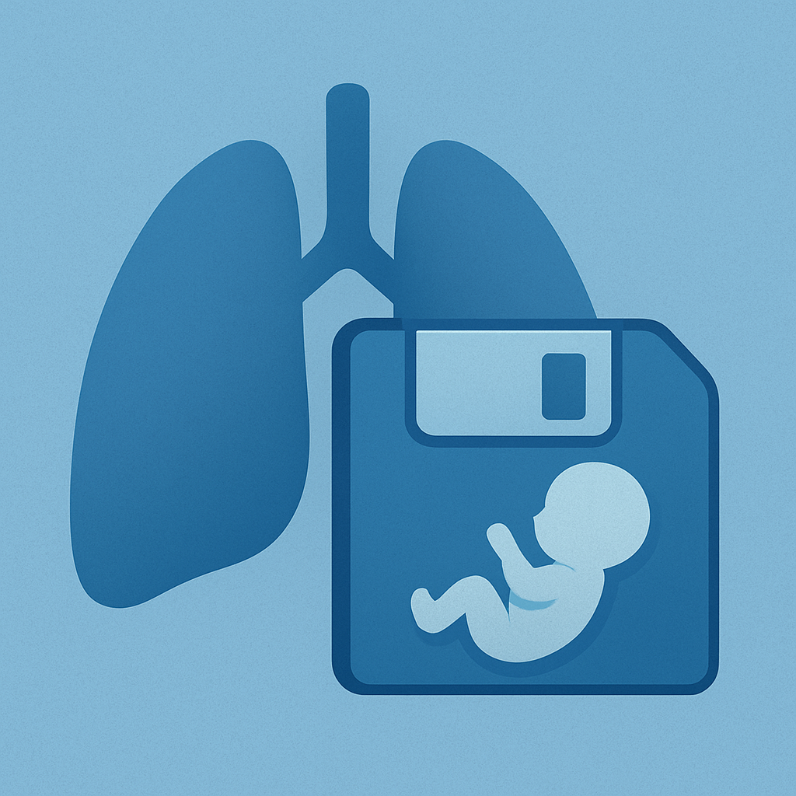
The Problem
Why ventilator data capture needs to be easier
Intensive care ventilators generate critical patient data — but capturing it consistently is hard
Long term data logging in SERVO very limited.
The Getinge Servo-logger requires a PC bedside
Manual data recording is error-prone and time-consuming for clinical staff
Existing solutions are often expensive, complex, or tied to proprietary hospital IT systems
How can we make ventilator data logging simple, portable, and independent?

Slide 3
Introducing LundaLoggern
A plug-and-play data logger for SERVO ventilators
Small, self-contained device — no hospital network or IT integration needed
Connects directly to the ventilator’s CIE port
Automatically records breath-by-breath data, settings, and waveforms to SD card
Built-in colour display shows live status at a glance
Built-in WiFi lets you download data from your phone or laptop

Slide 4
How It Works
Four simple steps — no training required
Step 1 — Plug in
Connect LundaLoggern to the ventilator’s CIE port
Data collection configuration can be made off-line
Step 2 — Auto-detect
The device identifies the ventilator and starts logging immediately
Step 3 — Enable WiFi
Press the button and scan the QR code on the display
Step 4 — Download
Open the web dashboard on your phone or laptop to review and download data files

Slide 5
What Gets Logged
Comprehensive, configurable data capture
Breath metrics
Tidal volume, respiratory rate, minute ventilation, FiO₂, PEEP, peak pressure, and more
Ventilator settings
Mode, patient category, compliance compensation, I:E ratio
Waveforms
Flow, airway pressure, volume, CO₂, Edi — fully configurable
All data timestamped automatically using the ventilator’s own clock
Choose which parameters to track via simple text files on the SD card

Slide 6
Key Features & Benefits
Designed for simplicity, privacy, and portability
Plug-and-play
No setup, training, or IT support needed
WiFi off by default
Minimises RF interference in the ICU
Connection possible only when requested
Portable & compact
Fits in a pocket; move between ventilators
SD card storage
Standard, removable, unlimited capacity
QR code connectivity
Connect to WiFi in seconds
Configurable logging
Adapt to research or clinical needs
Live display
Connection status, ventilator ID, timestamps
No cloud dependency
Data stays local — patient privacy ensured

Slide 7
Target Markets & Use Cases
Clinical / Neonatal ICU
Continuous monitoring for quality assurance
Research data collection during clinical studies
Biomedical Engineering
Performance verification and troubleshooting
Long-term trend analysis during service calls
Medical Device R&D
Bench testing and field validation of prototypes
Rapid data capture without proprietary software
Education & Training
Teaching tool for respiratory therapy programs
Live data demonstration during training sessions

Slide 8
Competitive Advantages
Why LundaLoggern stands out
No recurring costs
No licenses, subscriptions, or cloud fees
Vendor-independent data
Plain text files — open and portable
No hospital IT involvement
Standalone device with its own WiFi access point
Privacy by design
Data never leaves the device unless the user downloads it
Low-cost hardware
Built on the widely available ESP32-S3 platform
Fast deployment
Working in under a minute, zero configuration required

Slide 9
Product Demo
What you see on the device and on your phone
TFT display shows:
Ventilator type and serial number
SD card and COM status indicators
WiFi IP address and QR code
Web dashboard on any device:
File listing with timestamps
One-tap download and delete
Configuration viewer
SERVO Log Viewer
Device independent data viewer

Slide 10
Technical Snapshot
Quick reference — key specs at a glance
Hardware
LilyGo T-Display S3 (ESP32-S3), SD card reader, RS232 interface
Display
320 × 170 px colour TFT
Connectivity
WiFi access point — no internet needed
Protocol
SERVO CIE interface (standard on all SERVO ventilators)
Power
USB-C — can be powered from the ventilator’s USB port
Uses power only USB cable, i.e. no communication to ventilator Panel
Software
Open-source Arduino / PlatformIO firmware

Slide 11
Roadmap
Future possibilities
WiFi auto-shutoff after 5 minutes of inactivity
Bluetooth connectivity for direct mobile app integration
Multi-ventilator support — expand beyond SERVO to other brands
Cloud sync option (opt-in) for centralized research data collection
Real-time trend graphs on the web dashboard
Battery operation for transport and ambulance use
Regulatory pathway — CE marking / FDA clearance for clinical deployment

Slide 12
Call to Action
“We have a working prototype — let’s bring it to market.”
What we need from marketing:
Market sizing and customer segmentation feedback
Input on branding, naming, and visual identity
Channel strategy — direct sales, distributors, OEM partnerships?
Pricing model validation

Slide 13
Q & A
Thank you!

Slide 15
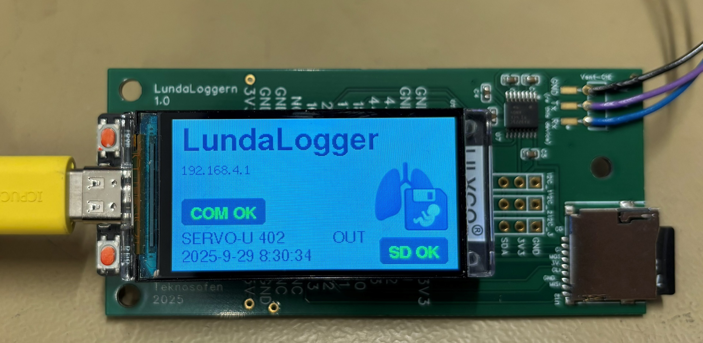
LundaLoggern

Slide 16
LundaLoggern

